Slide 1
Azure Databricks

Slide 2
Typical Data Science Cycle
Data Collection
MLOps
(Model Deployment)
Business Insights & Understanding
Data Understanding
Model Building & Evaluation
Data Pre-Processing

Slide 3
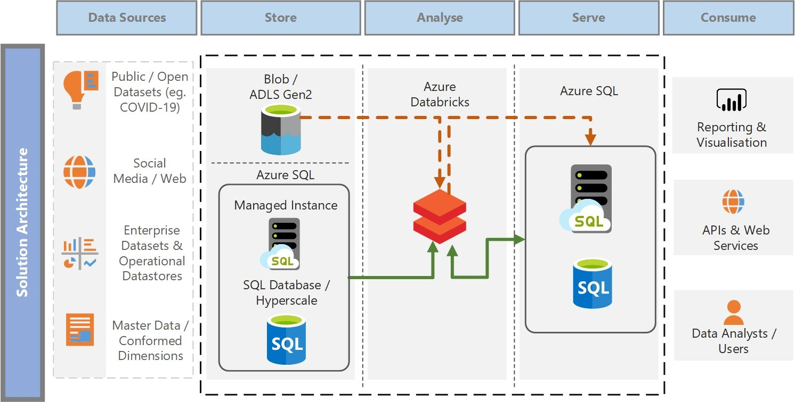
Azure Databricks
Azure Databricks is the jointly-developed data and AI service from Databricks and Microsoft for data engineering, data science, analytics and machine learning. Databricks is a version of the popular open-source Apache Spark analytics and data (Or Big Data) processing engine.
Azure Databricks is optimized for Azure and tightly integrated with azure cloud services

Slide 4
Azure Databricks
Azure databricks is similar to jupyter notebook. We can select version of python in databricks notebook.
Azure Databricks offers three environments
Databricks SQL
Databricks Data Science & Engineering
Databricks Machine Learning

Slide 5
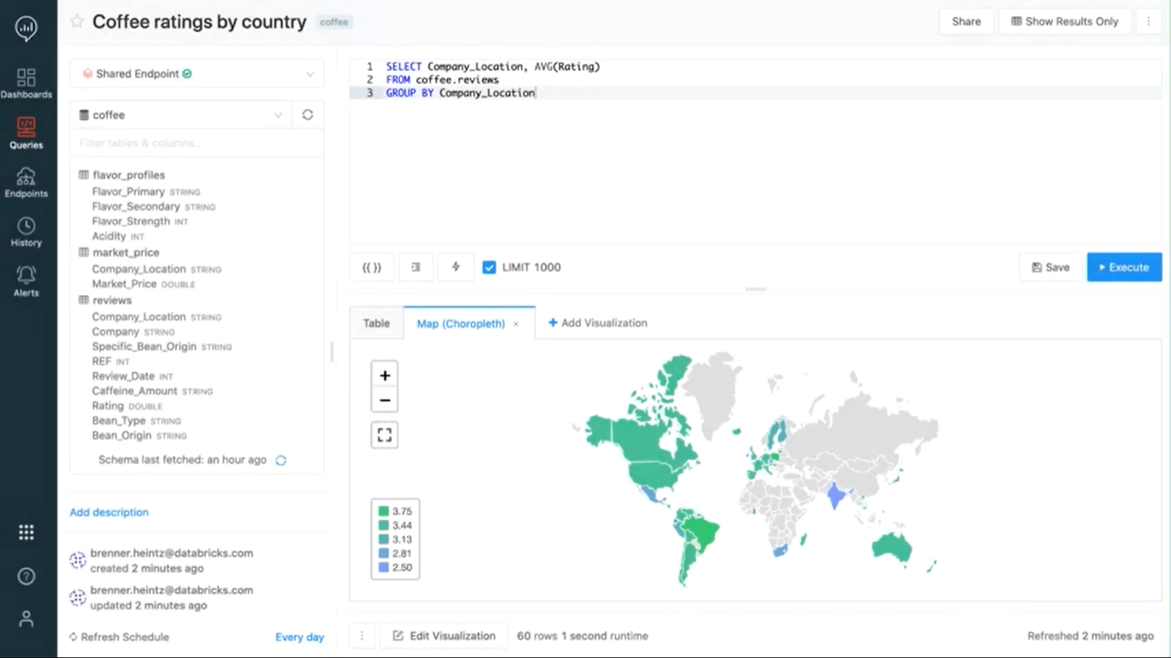
Azure Databricks
Databricks SQL helps analysts to run SQL queries on their data lake,
create different visualizations, and build and share dashboards. This
is also called SQL analytics.
it is very helpful for SQL developers.
Tables and databases can be created to make use of SQL.

Slide 6
Azure Databricks
Databricks Data Science & Engineering provides an interactive workspace that enables collaboration between data engineers, data scientists, and machine learning engineers. We use Azure Databricks to read data from multiple data sources and turn it into breakthrough insights using Spark.
Workspace have following assets which are used by data engineers and data scientists :
Cluster : spark cluster
Notebook : Databricks web-based IDE
Jobs : scheduled tasks such as ETL through notebook
Libraries : Python packages
Data : Stored data in DBFS
Repos: Databricks folders
Models : Registered model
Experiments : An organized machine learning project folder

Slide 7
Azure Databricks
Databricks Data Science & Engineering
Following are interface by which we access assets of azure data bricks :
UI : The Databricks UI provides an easy-to-use graphical interface to workspace folders and their contained objects, data objects, and computational resources (We will use UI in this training)
Rest API : There are 2 Rest APIs (REST API 2.0 and REST API 1.2.) to access assets.
CLI (command line interface) : Through commands we can access our assets.

Slide 8
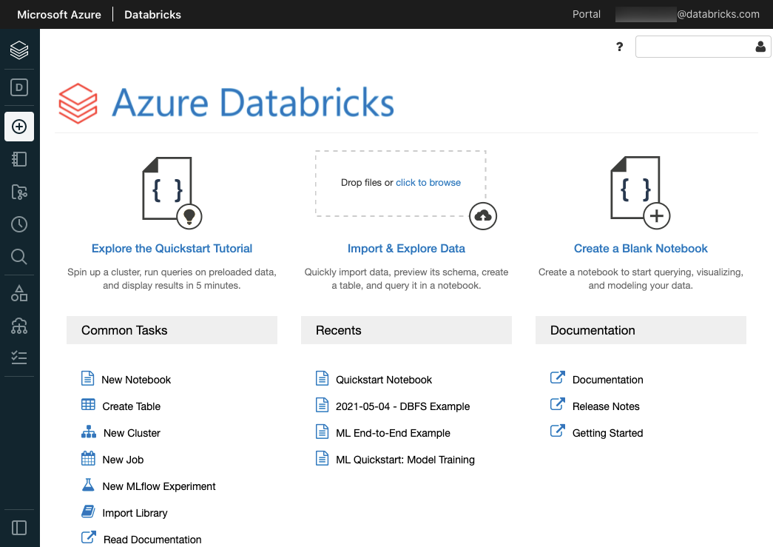
Azure Databricks UI

Slide 9
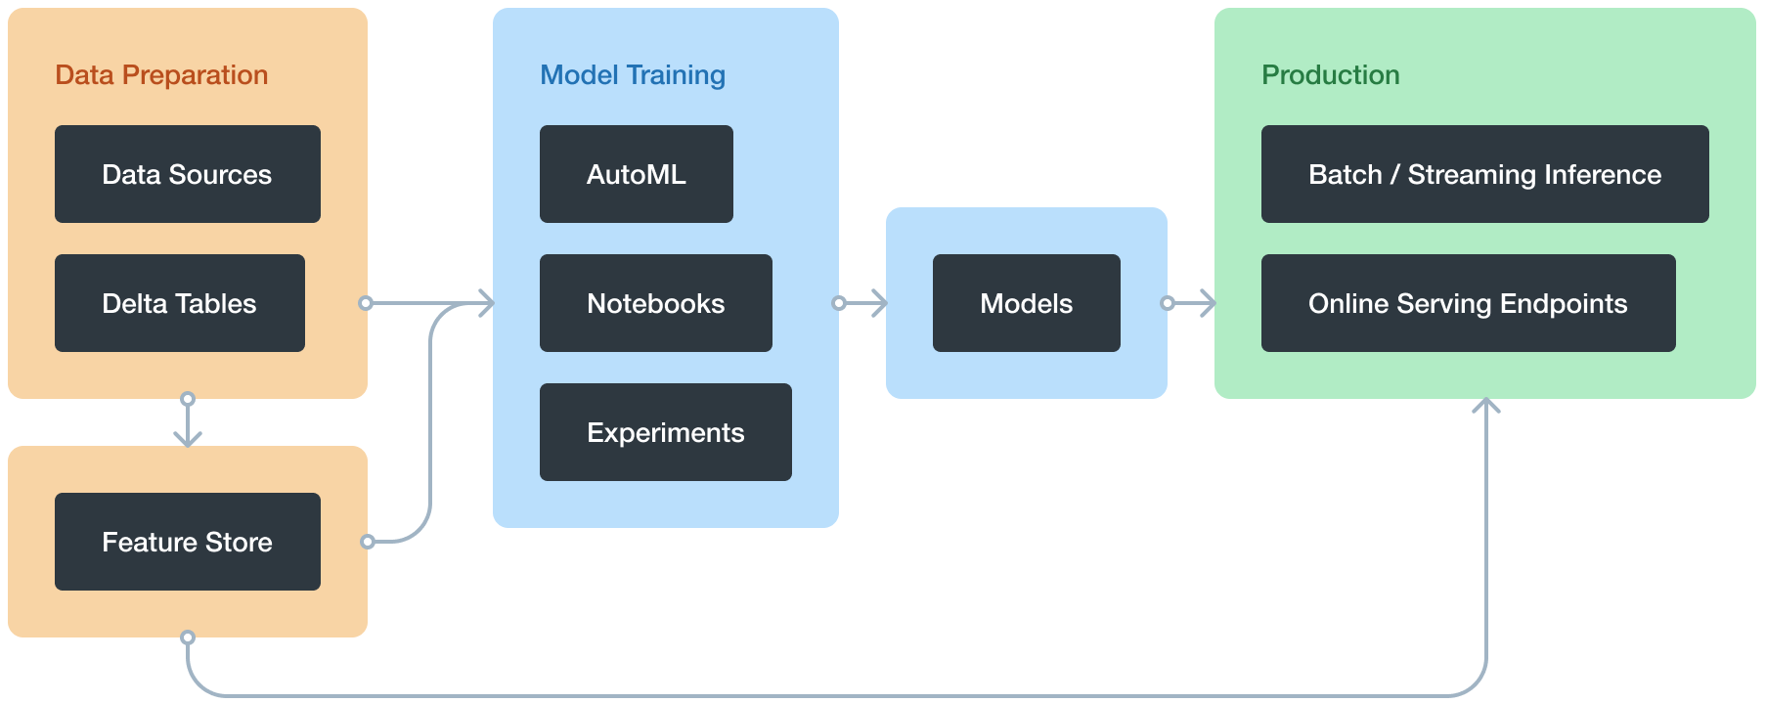
Azure Databricks
Databricks Machine Learning is an integrated end-to-end ML environment with managed services for Model Registry, Loading & Tracking of the models.
It also supports API Services where it will work as Model-As-A-Service Platform
Track training parameters and models using experiments with MLflow tracking
Notes:
https://docs.databricks.com/applications/machine-learning/index.html

Slide 10
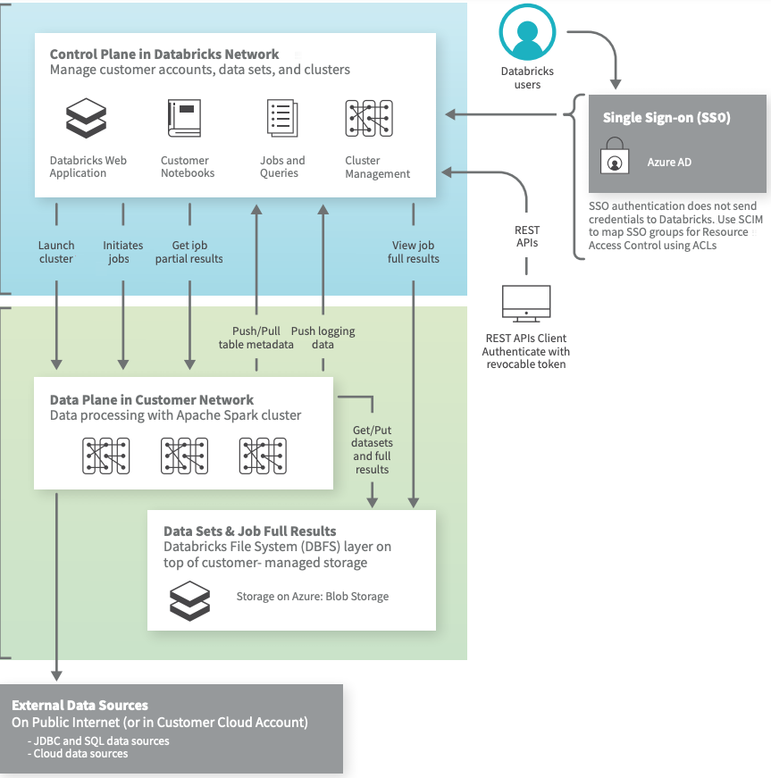
Azure Databricks Architecture
As a fully managed, Platform-as-a-Service (PaaS) offering, Azure Databricks leverages Microsoft Cloud to scale rapidly, host massive amounts of data effortlessly, and streamline workflows for better collaboration between business executives, data scientists and engineers.
The Databricks control plane runs and controls clusters inside your cloud account (data plane) using your compute to process the data in your cloud storage. All communications between control and data planes happen through the cloud providers private network (VNET) and are not sent over the public network.
This ensures security through isolation.

Slide 11
Azure Databricks Architecture
The following are the key components that are part of the platform:
Notebook
Experiment
DBFS
Tables & Databases
Cluster
Model Management

Slide 12
Azure Databricks UI

Slide 13
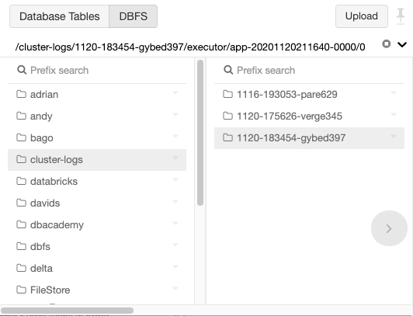
Data Management
Databricks File System (DBFS)
A filesystem abstraction layer over a blob store. It contains directories,
which can contain structured as well as unstructured
(data files, libraries, and images), and other
directories. DBFS is automatically populated with some datasets that you
can use to learn Azure Databricks.
Allows you to mount storage objects so that you can seamlessly access data
Allows you to interact with object storage using directory and file semantics instead of storage URLs.
Persists files to object storage, so you won’t lose data after you terminate
a cluster. You can see data in DBFS even if you terminate cluster.
DBFS System Access Through UI

Slide 14
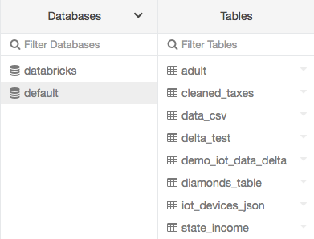
Data Management
Database
A collection of information that is organized so that it can be easily
accessed, managed, and updated. Typically they are a collection of
different tables. (For structured data only)
Table
A representation of structured data. You query tables with Apache
Spark SQL and Apache Spark APIs. There are Global Tables that can
be accessed across Clusters & local tables that are cluster specific.
local table is also known as a temporary view.
A Database can be created using SQL command.
A table can be created under any database using UI as well as SQL command
You can not see database/tables if you terminate cluster.
DB and tables through UI

Slide 15
Model Management
An MLflow run corresponds to a single execution of model code. Each run records the following information:
Source: Name of the notebook that launched the run or the project name and entry point for the run.
Version: Notebook revision if run from a notebook or Git commit hash if run from an MLflow Project.
Start & end time: Start and end time of the run.
Parameters: Model parameters saved as key-value pairs. You can try multiple model parameters for different model building practise
Metrics: Model evaluation metrics saved as key-value pairs. The value is numeric. It helps in logging metrics, compare them with runs, Visualize metrics over time across different models
Artifacts: Output files in any format. YAML configuration files

Slide 16
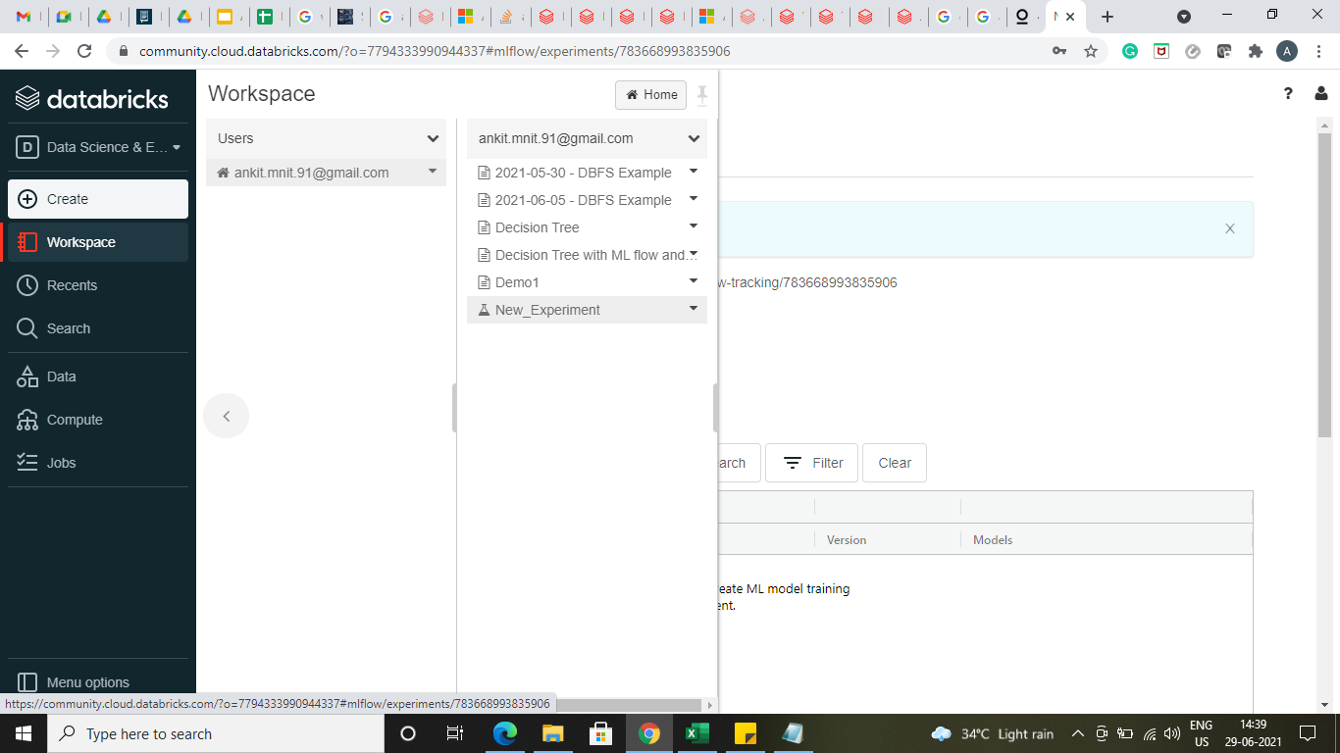
Model Management
Model Experiment MLflow experiments let you visualize, search for, and compare runs, as well as download run artifacts and metadata for analysis in other tools. The Experiments page gives you quick access to MLflow experiments across your organization.

Slide 17
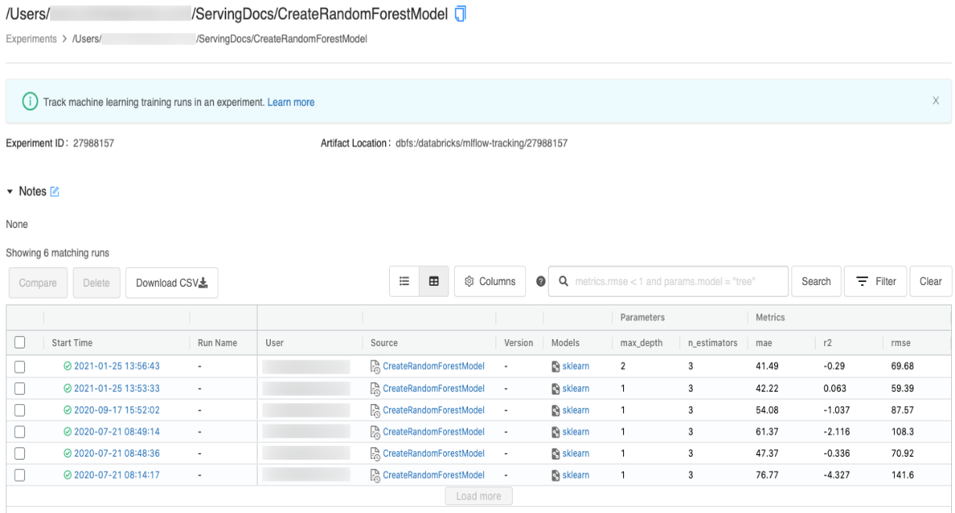
Model Management
The following are some of the key advantages of Model Experiment:
Model metrics
Track multiple runs
Compare Models
Load experiments
Manage Model API
Manage Multiple parameters
Filter Runs
Visualize Run Details

